Slide 1
Light Ranger
Cendrine Dedise
Focus puller

Slide 2
sommaire
Preston FI+Z system
There are 3 LR2 models
Connection diagram
Video Interface Unit settings
LR2 position
LR2 calibration
Ranging mode
Manual Mode / AutoFocus Mode
Transition from Manual Mode to AutoFocus Mode
Control AF Zone
Freeze focus
HU4 unit adjustments

Slide 3
There are 3 LightRanger2 models
LR2-M (as in Mini)
LR2-W (as in Wide)
LR2 (Original)

Slide 4
Preston FI+Z System
The light Ranger operates exclusively with the Preston FI+Z System.
A full FI-Z (focus,iris,zoom) system consisting of:
1. MDR3 or MDR4 (motor driver receiver)
2. HU3 or HU4 (hand unit)
3. Digital Lens motors: DMX1 or DMX2 or DM5

Slide 5
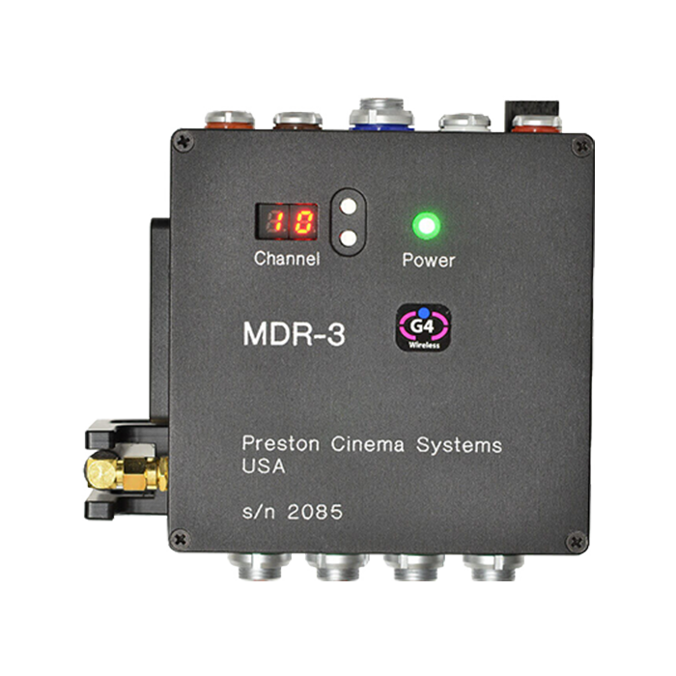
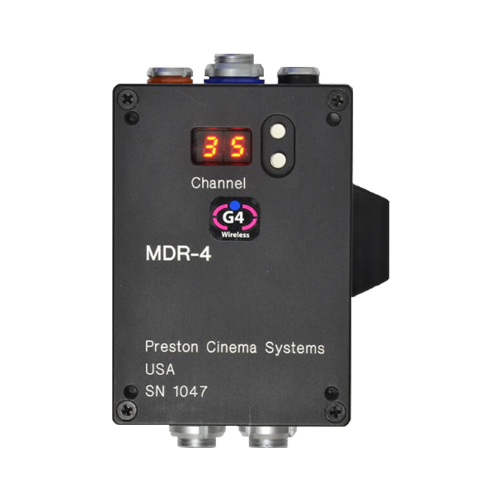
MDR3 or MDR4 (motor driver receiver)
MDR3 has 4 channels
(focus, iris, zoom, other)
MDR4 has 2 channels (focus,iris)

Slide 6
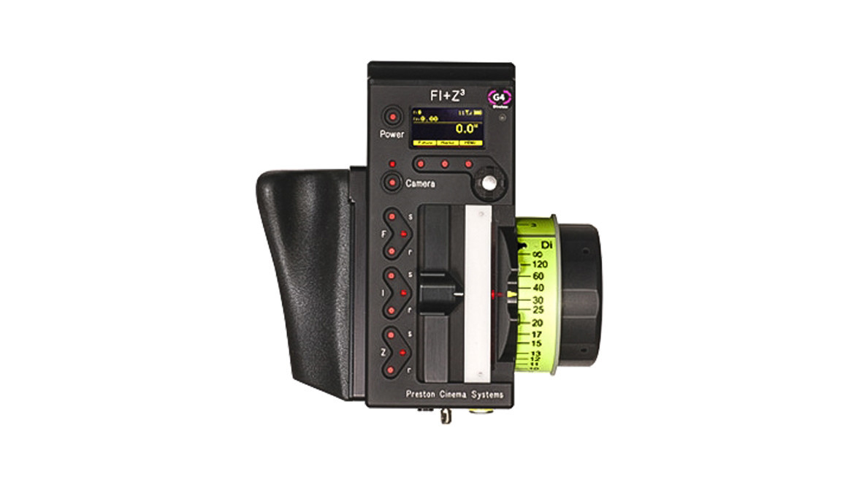
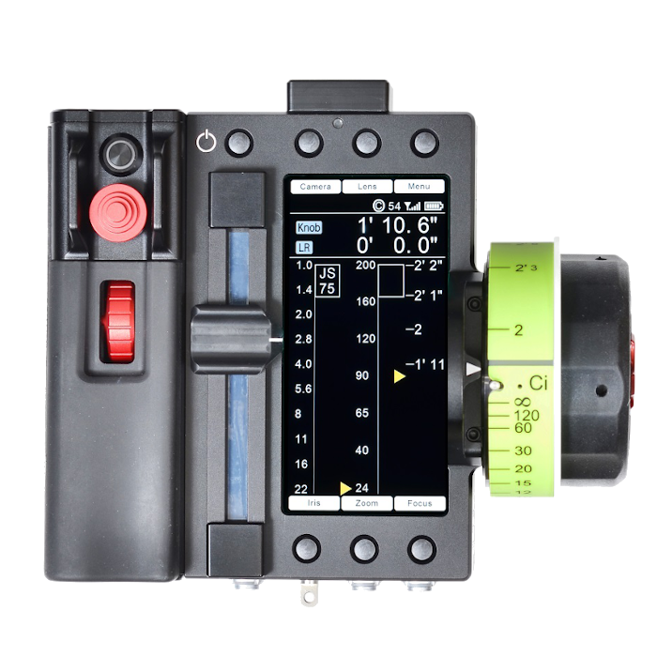
HU3 or HU4 (hand unit)

Slide 7
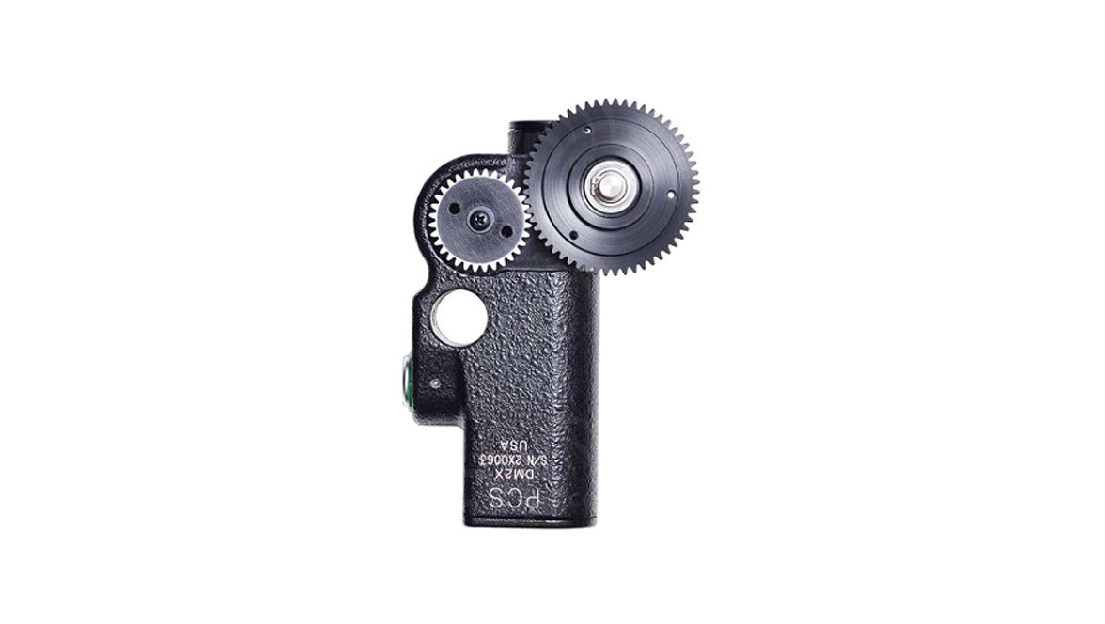
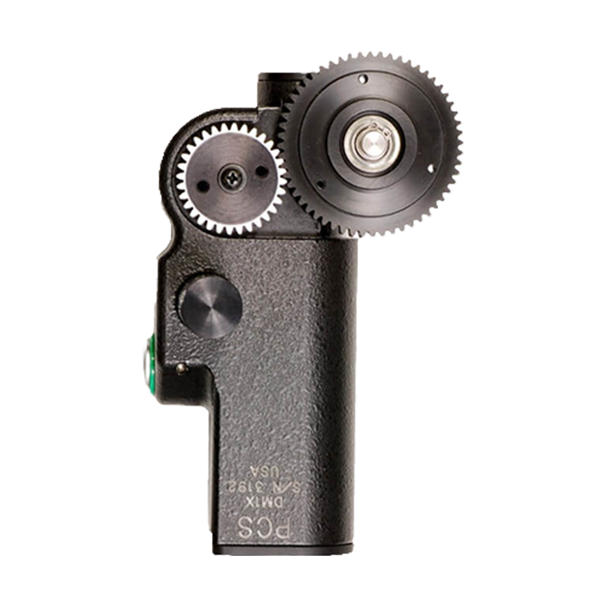
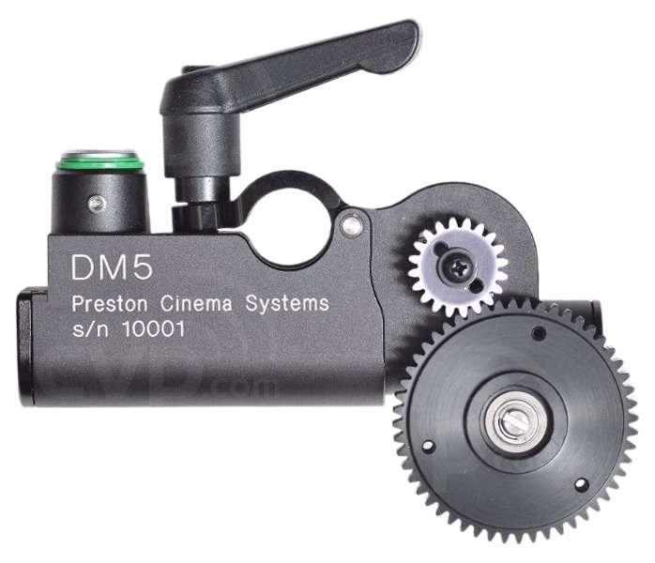
Digital Lens motors (DM1X,DM2X,DM5)
DM1X
DM2X
DM5 is lighter and smaller

Slide 8
Differences LR2 models
LR2-M
LR2-W
LR2

Slide 9
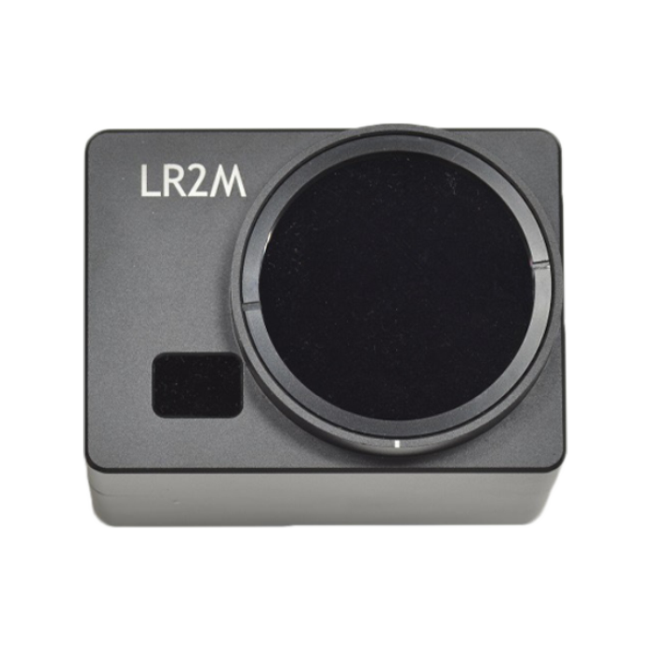
LR2-M
focusing on Large Format
Is for mid to long focal lenght lenses
16 indepedent measurement zones cover
20° horizontal field of view

Slide 10
LR2-M Specifications
Horizontal angle of view: 20°
Vertical angle of view: 3°
Number of detection zones: 16
Size: 3.9 x 2.8 x 2.5 inches
Weight: 592g
Power : 2-pin Lemo to D-Tap power cable

Slide 11
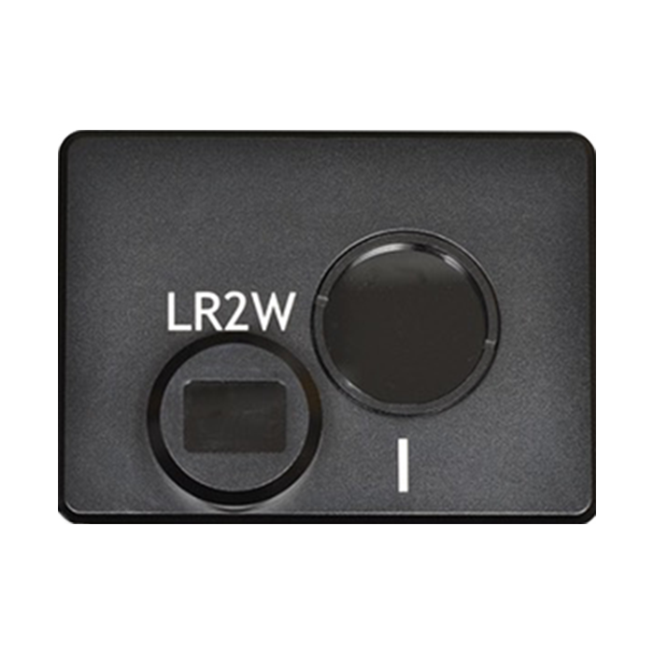
LR2-W
Optimized for wide angle anamorphic lenses
Optimized for steadicam
Hand-held shots

Slide 12
LR2-W Specifications
Horizontal angle of view: 50°
Vertical angle of view: 3°
Number of detection zones: 16
Size: 3.9 x 2.8 x 2.5 inches
Weight: 592g
Power : 2-pin Lemo to D-Tap power cable

Slide 13
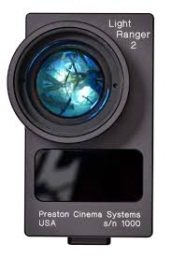
LR2
Horizontal angle of view: 20°
Vertical angle of view: 3°
Number of detection zones: 16
Size: 3 x 5 x 1.5 inches
Weight: 800g?
Power : 2-pin Lemo to D-Tap power cable

Slide 14
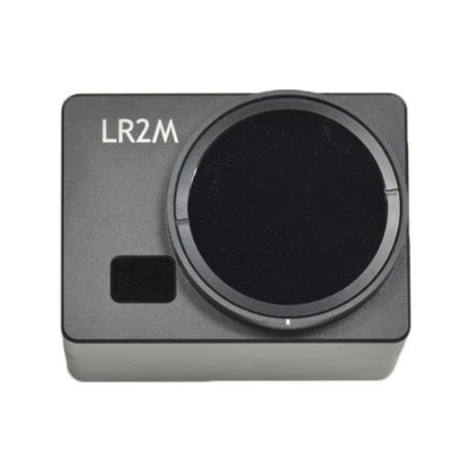
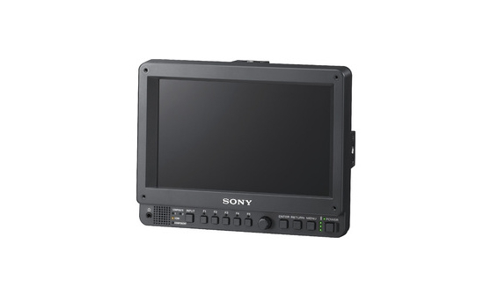
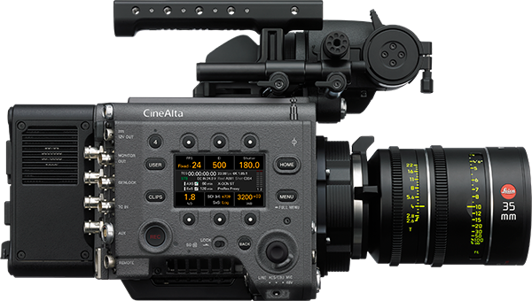
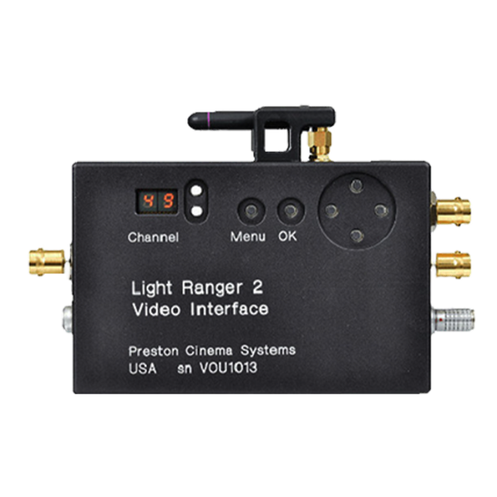
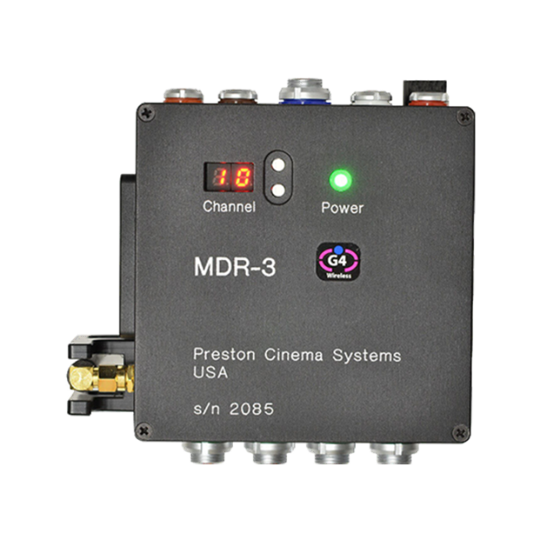

Slide 15
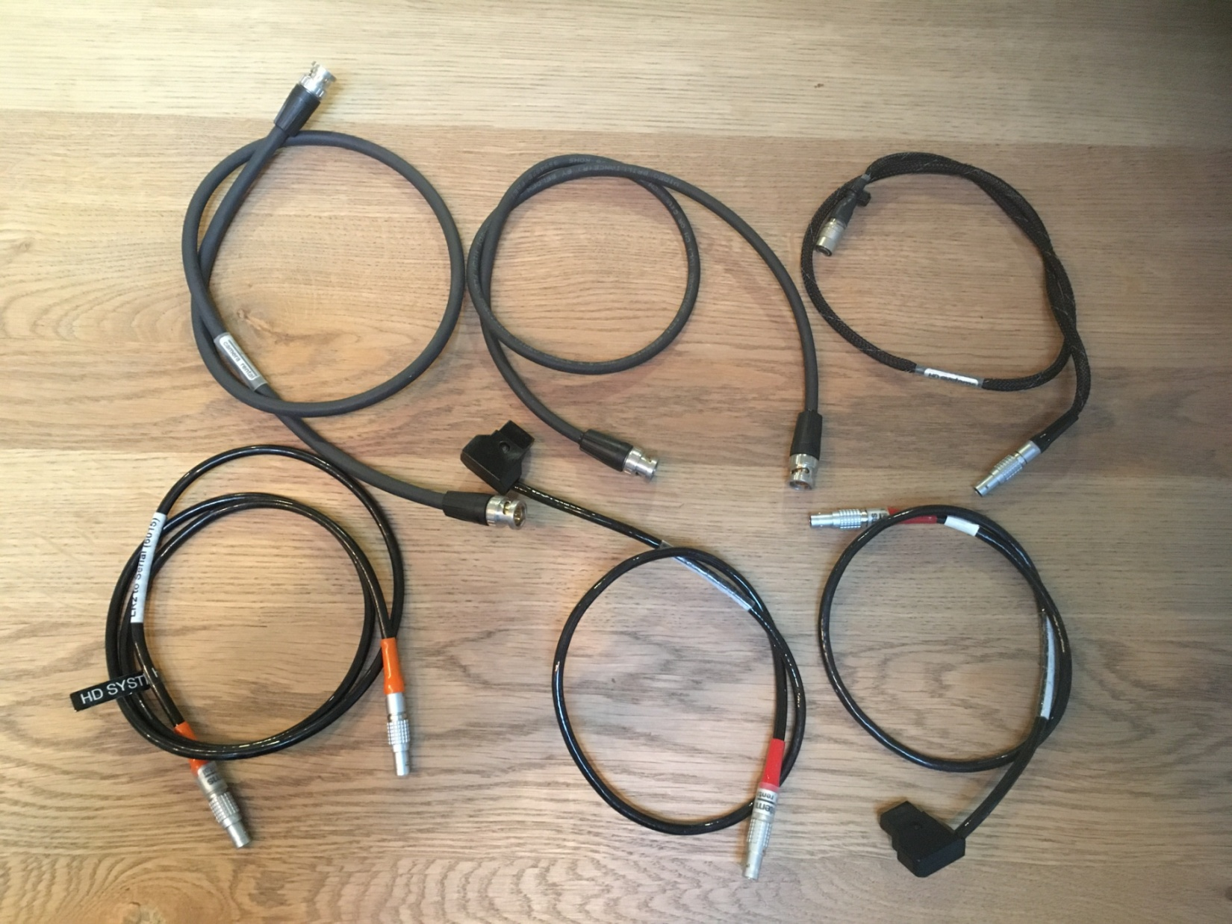
BNC cable
BNC cable
Monitor power
Serial cable
MDR power
VIU power

Slide 16
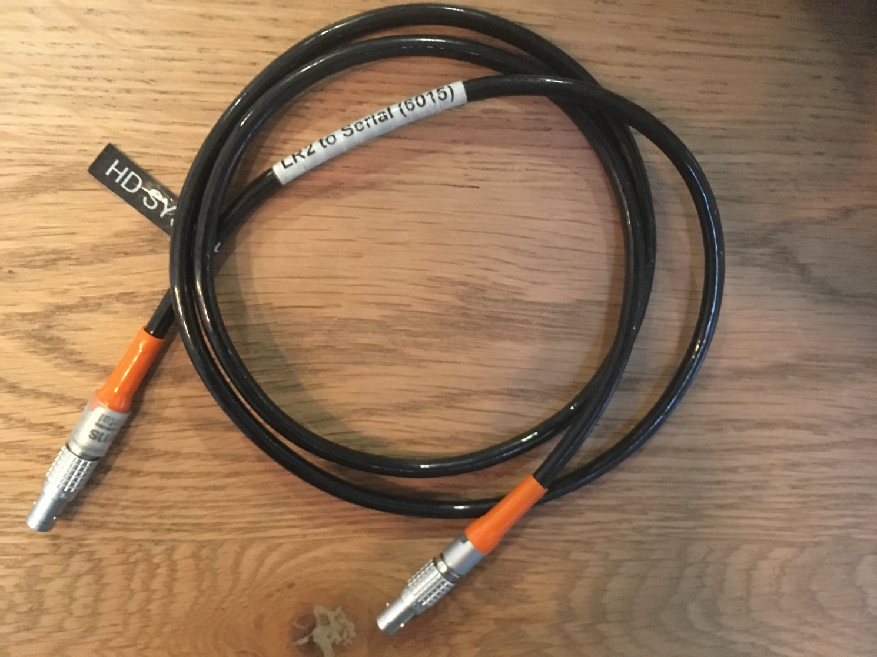
Serial cable from LR2 to MDR

Slide 17
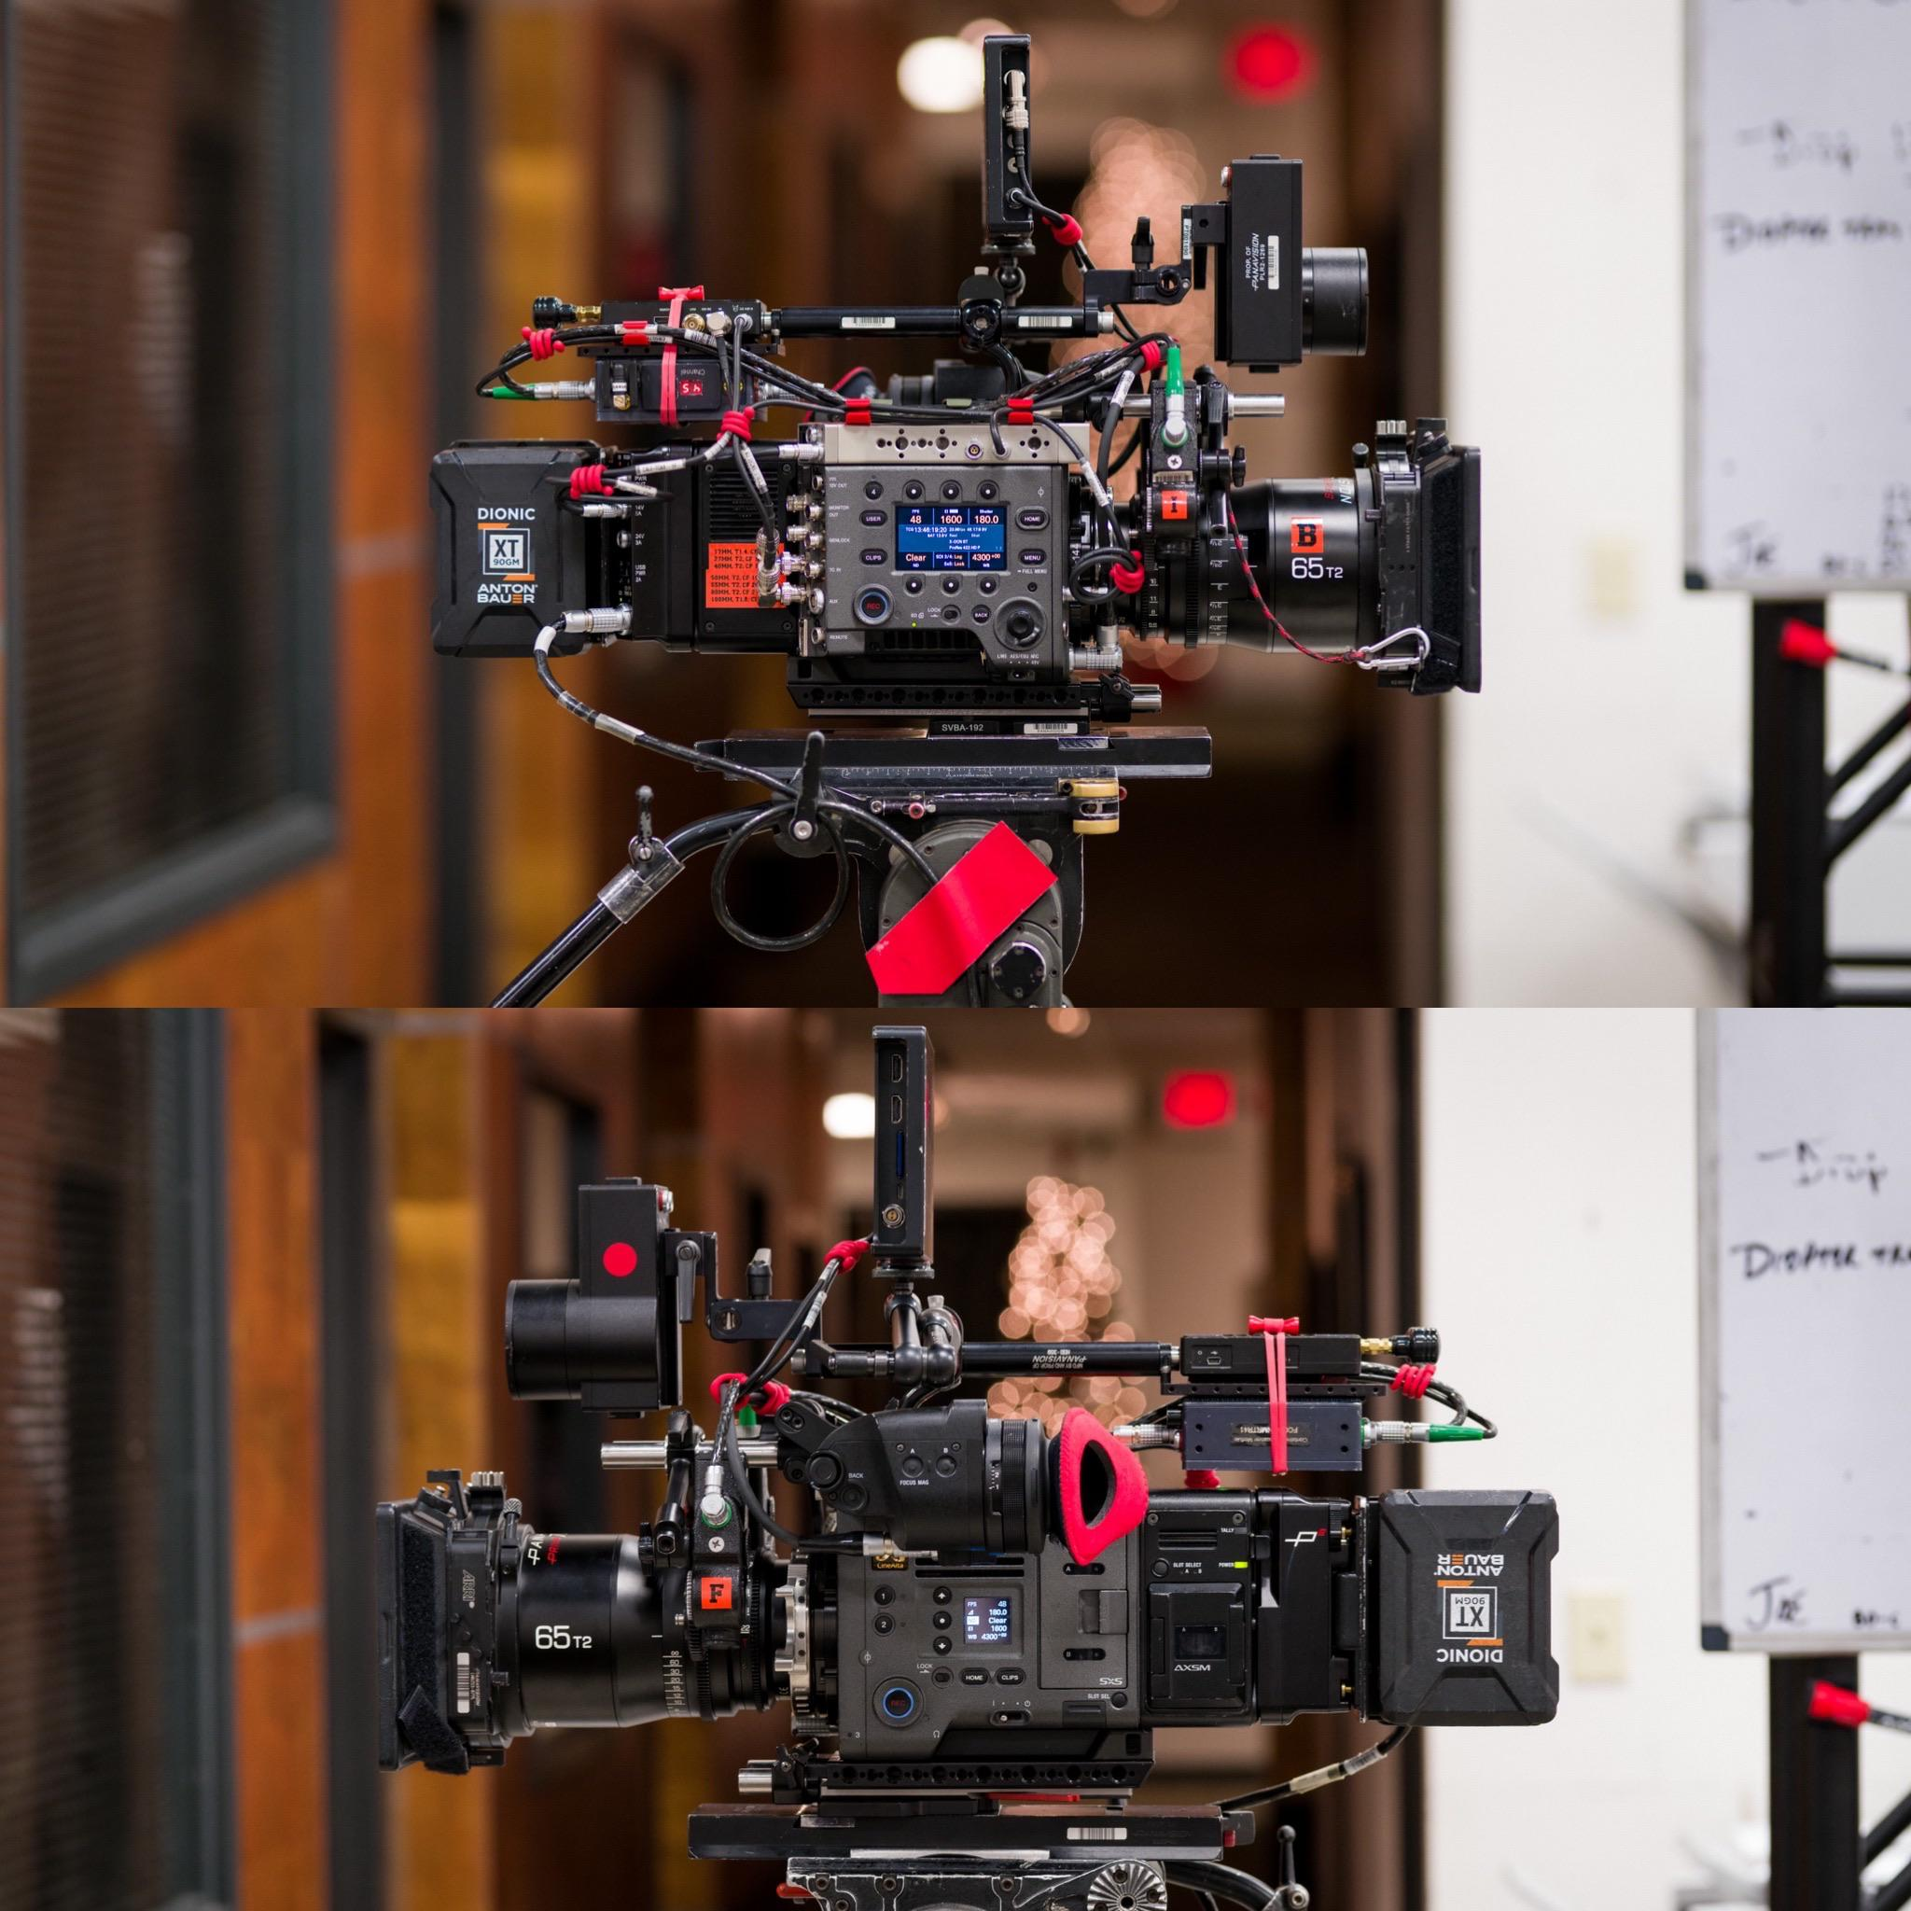

Slide 18
Connection Diagram
power
Serial
Serial
D-Tap
D-Tap
SDI OUT
CAMERA
BNC cable
Loop-thru*
SDI IN
input
BNC cable
overlay
power
*Loop-thru = clean video/ overlay = video + overlay

Slide 19
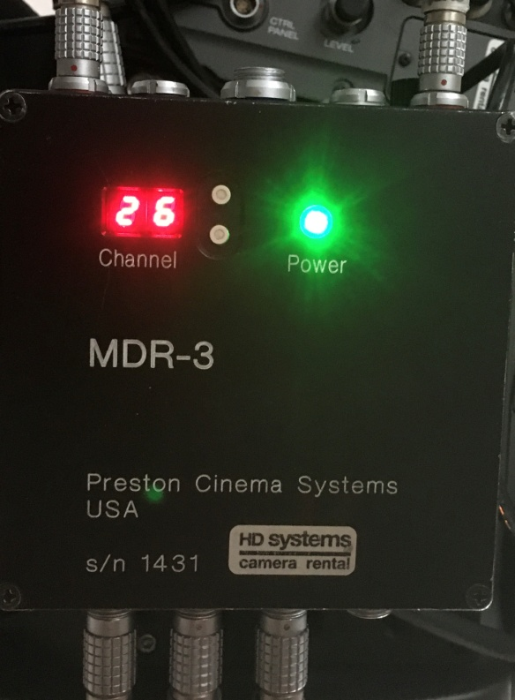
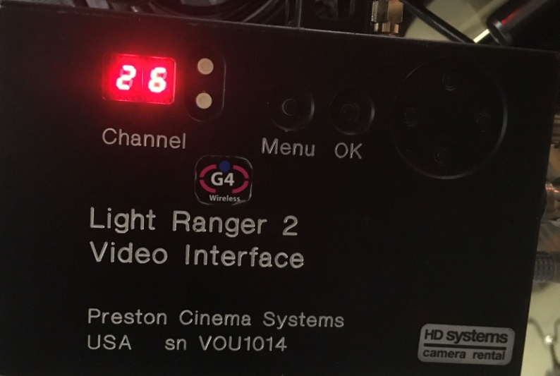
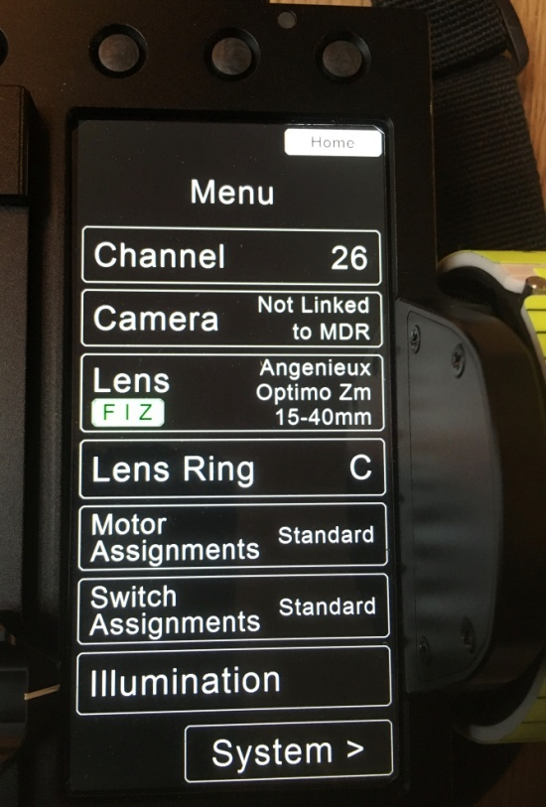
Check MDR, VIU,HU Channel
HU4
To change channel, press the first button until channel is flashing and use keys to increase/decrease

Slide 20

Video Interface (VIU) Menu Setup
Press Menu to set
Cam Manuf
Cam Model
Cam Res
East/west switches to increment/decrement the displayed value
Press OK when done

Slide 21
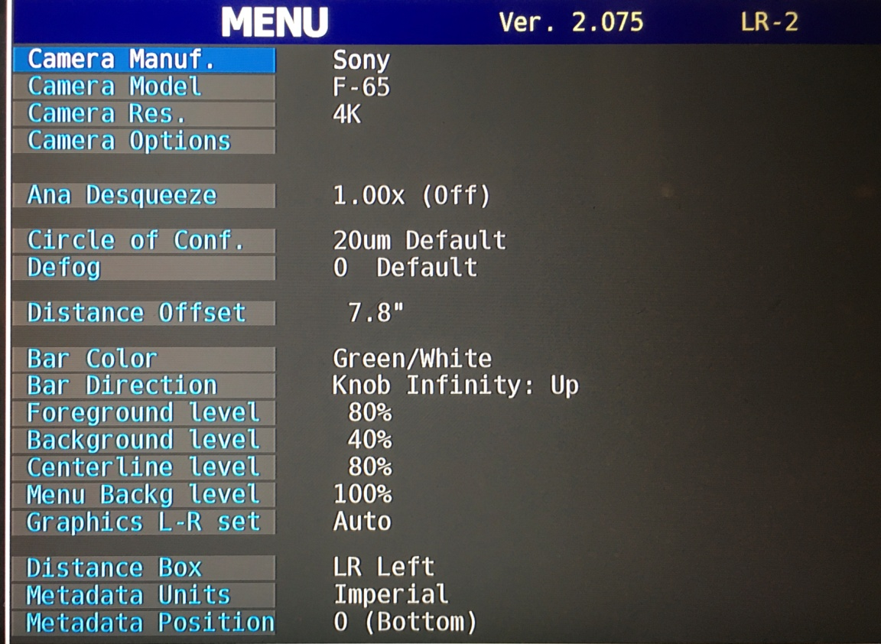
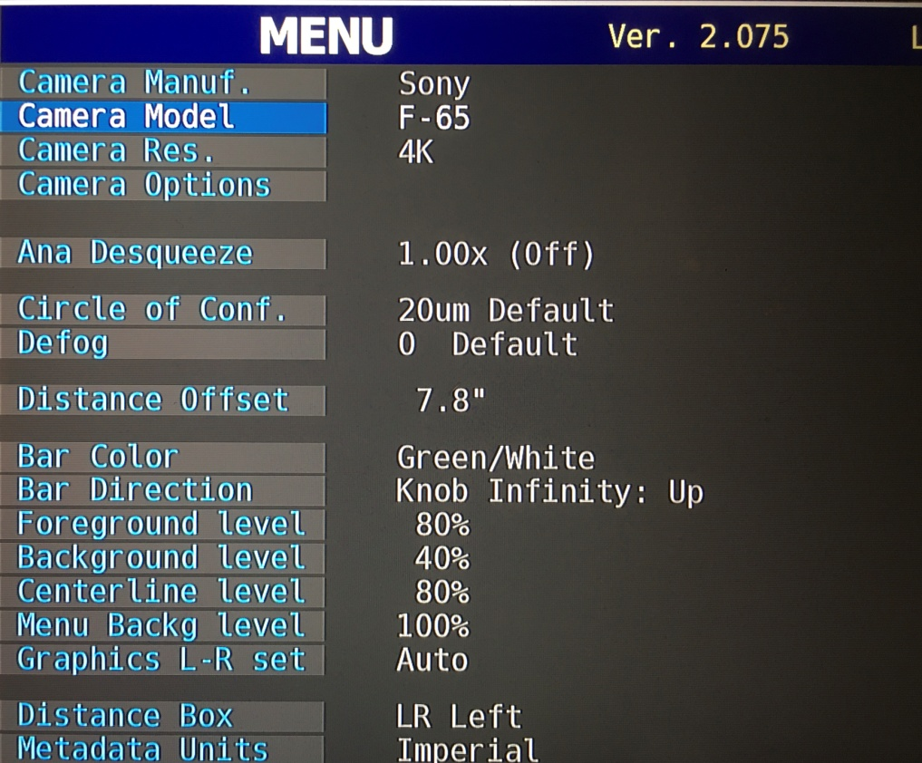
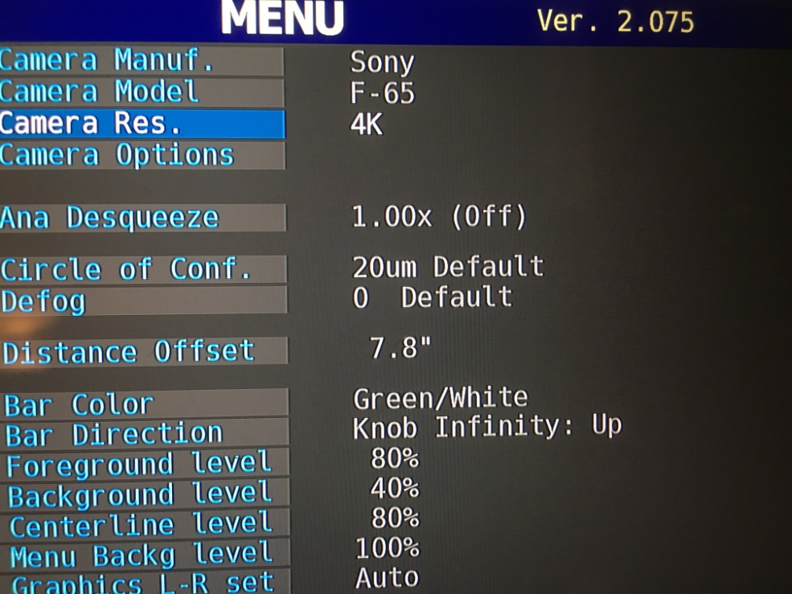

Slide 22
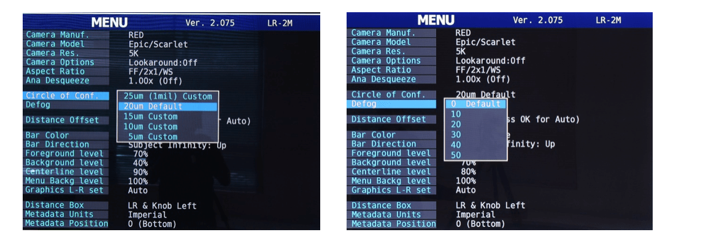
Circle of Conf and Defog
The Defog setting (above) increases the usable distance in the presence of haze, fog, or smoke. Start with setting 10 for haze or light fog. Higher values of the setting will decrease the maximum operating distance.

Slide 23
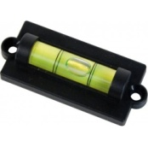
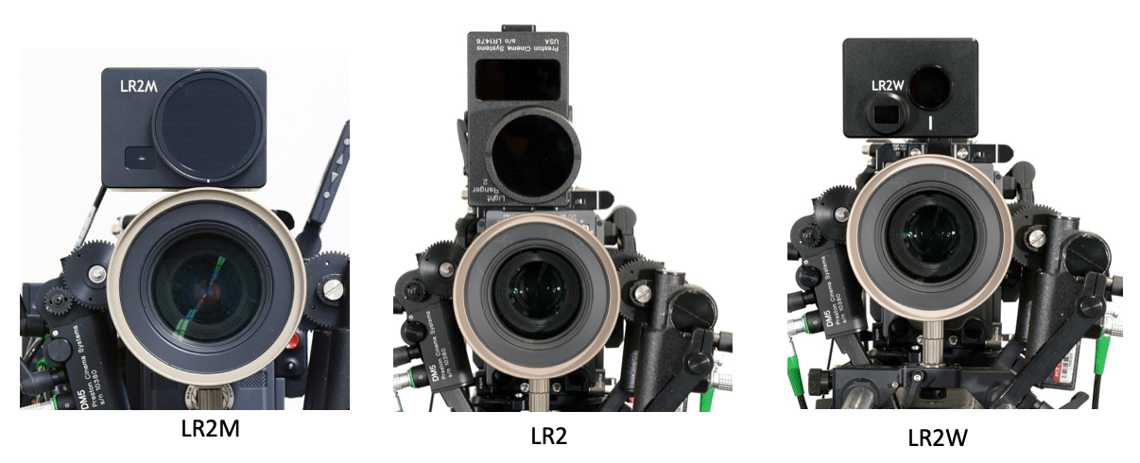
LR2 unit position
Set LR2 as close to the lens as possible (to minimize parallax)
2. Center the LR2 receiver lense (round opening) horizontally
3. Adjust the tilt angle (tilt adjustment) to minus 2

Slide 24
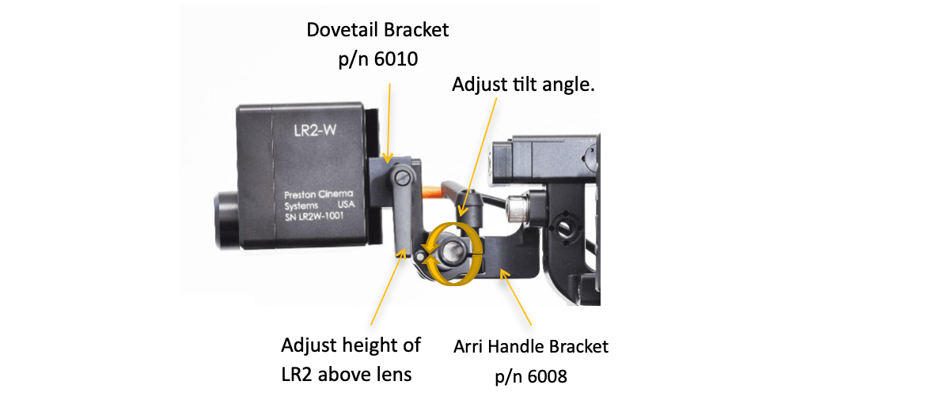
Adjust tilt angle

Slide 25
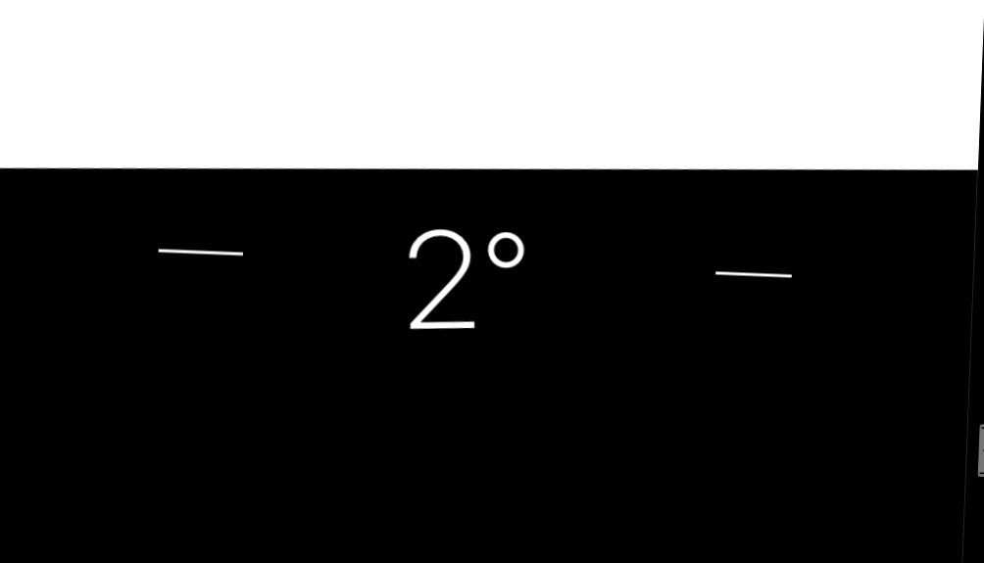

Slide 26
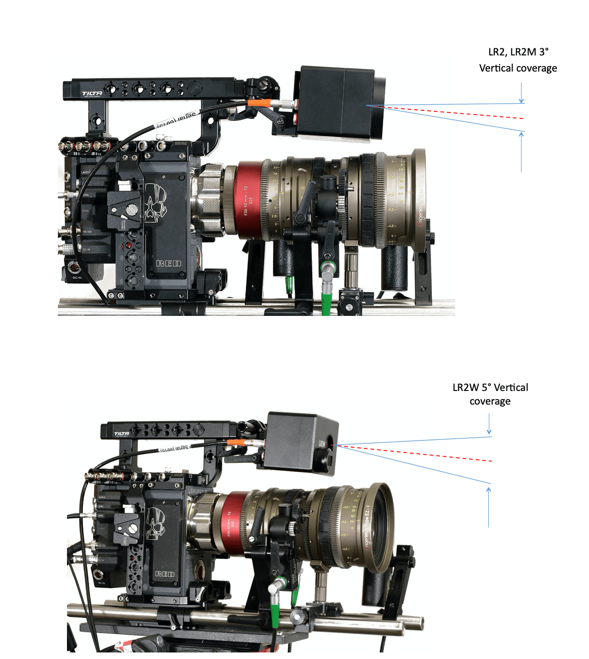

Slide 27
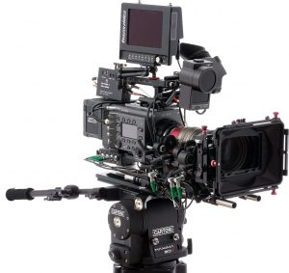
LR2 calibration
The Distance Offset Calibration corrects the distance measurement to the subject for the offset between the LR2 and the image plane of the camera.
Distance offset
The offset can either be entered manually or using the Auto Offset option.

Slide 28
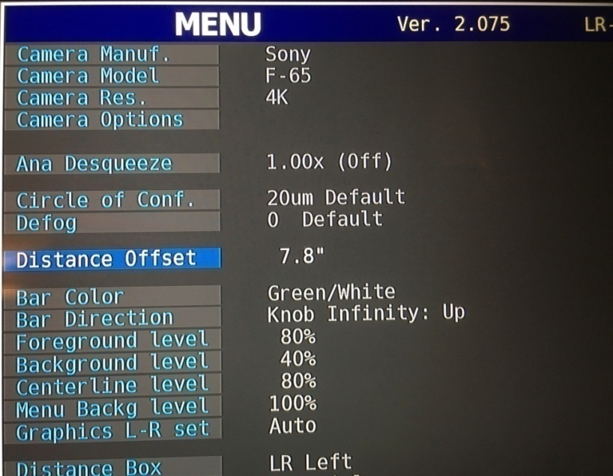

MANUAL INPUT
The offset distance is measured from the rear surface of the LR2 to the camera focal plane. After selecting the Distance Offset menu item, use the East/West Navigation key on the VIU to increase/decrease the distance offset.

Slide 29


AUTO OFFSET OPTION
Set the Light Ranger to Manual Mode from the HU3/HU4
Open the lens iris fully
If using a zoom, set to the longest focal length
Select the « distance offset » Menu VIU item
Press OK on the VIU
Position the face at 4 feet (close focus distance), between the parallel red lines shown on the monitor
Use the North/South joystick (HU4) or keys (HU3) to adjust the distance between the red lines to cover the subject
If necessary adjust the tilt angle of the LR2 so that it is measuring the subject
Critically focus on the subject from the hand unit
Press OK on the Video Interface Unit
Memorize distance offset
Check calibration (see below)

Slide 30
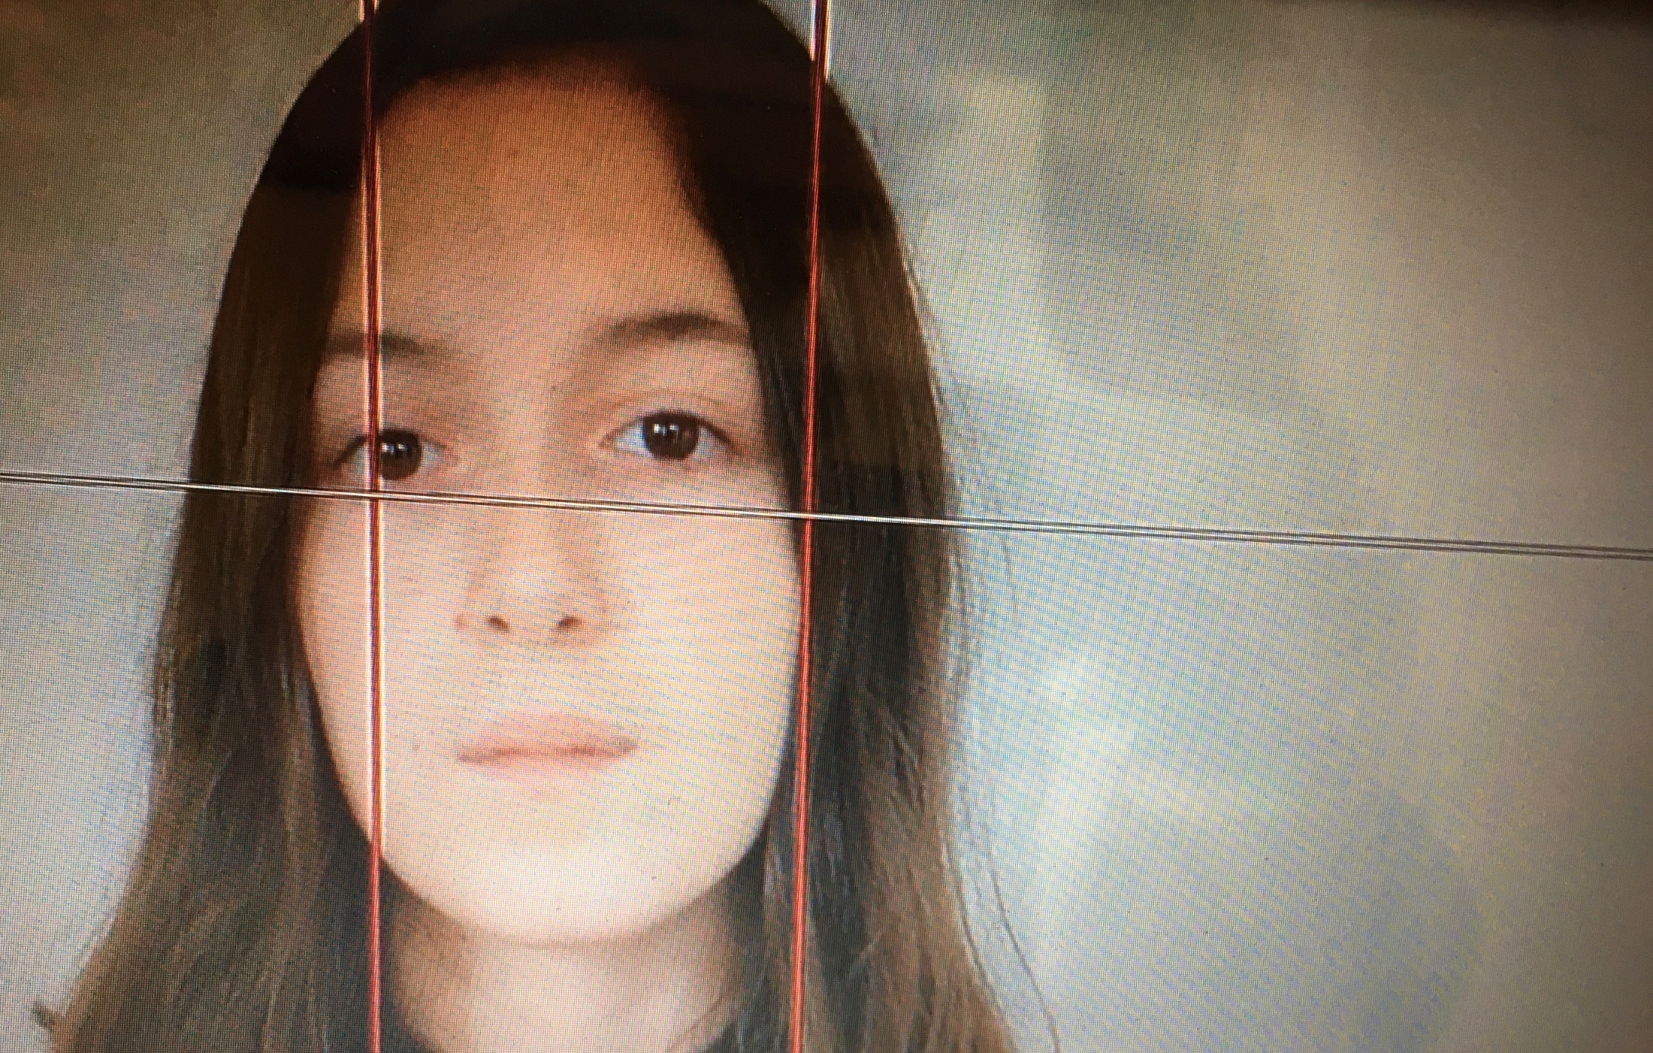

Slide 31
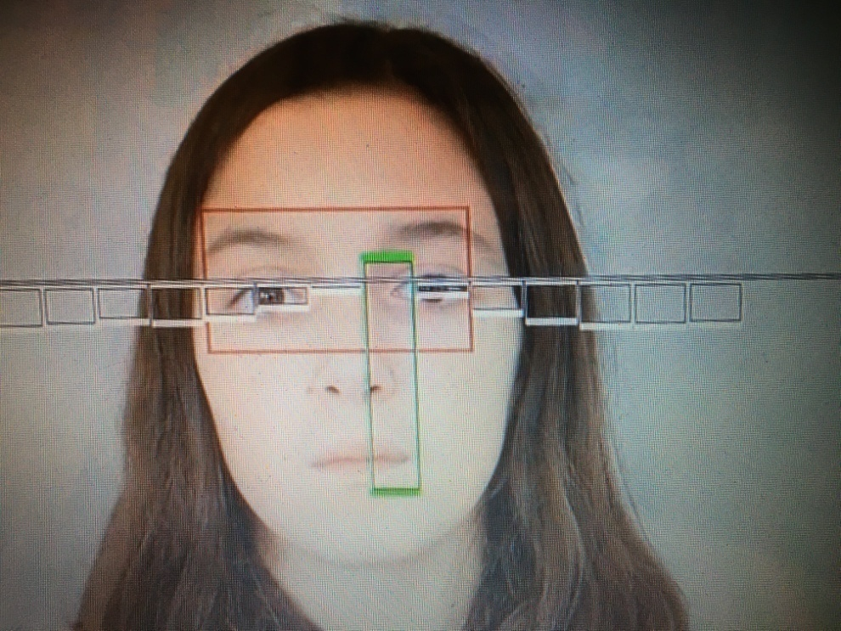
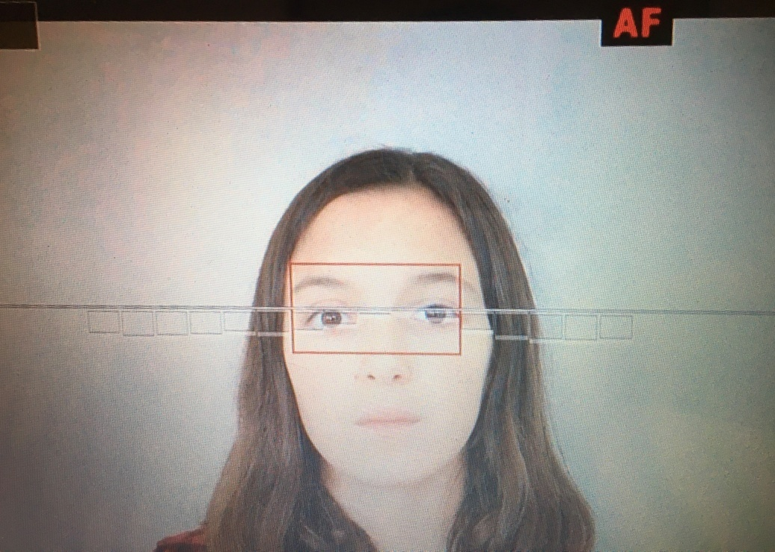
To check if calibration is right, press Menu so green bargraph appears
Set the LR to Auto Mode from the HU, red rectangle appears
If the focus is the same, so the calibration is correctly done

Slide 32
Selecting LR Mode
Basic Ranging mode
Manual Focus mode / AutoFocus mode
Hybrid mode

Slide 33
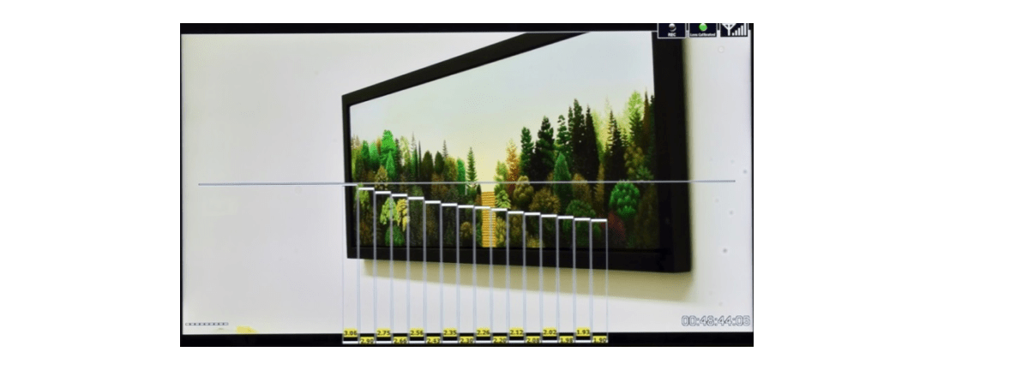
Basic ranging mode
Enter the Basic Ranging Mode by pressing the OK button on the Video Interface Unit
16 distances
The distances from the camera focal plane to the subject within each of the zones is displayed at the bottom of each rectangle, forming a “depth map” of the scene

Slide 34
Change Mode
Press OK from the VIU to change MODE

Slide 35
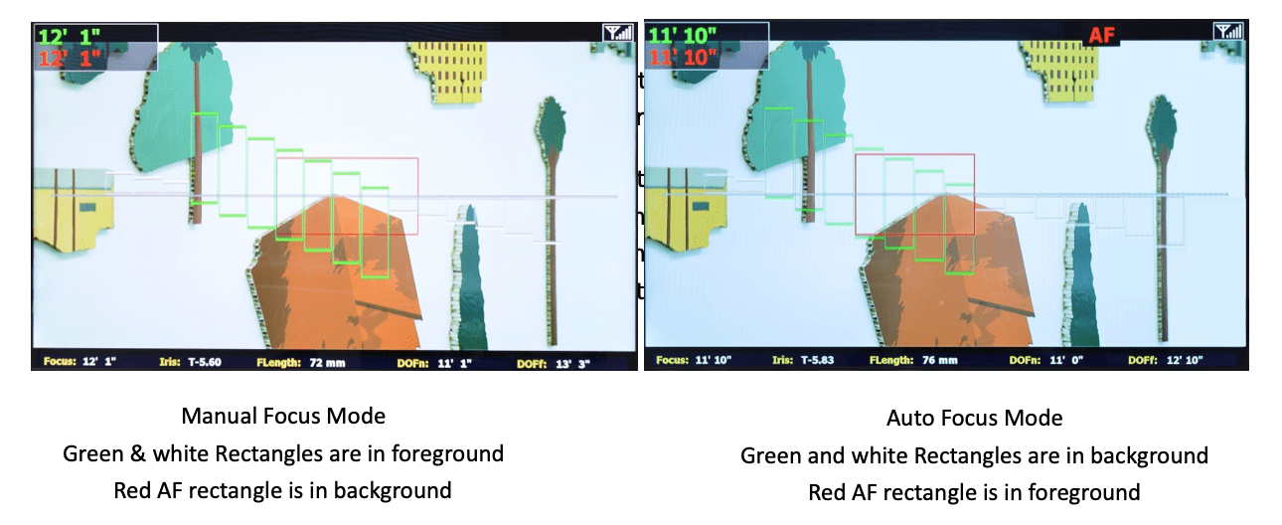

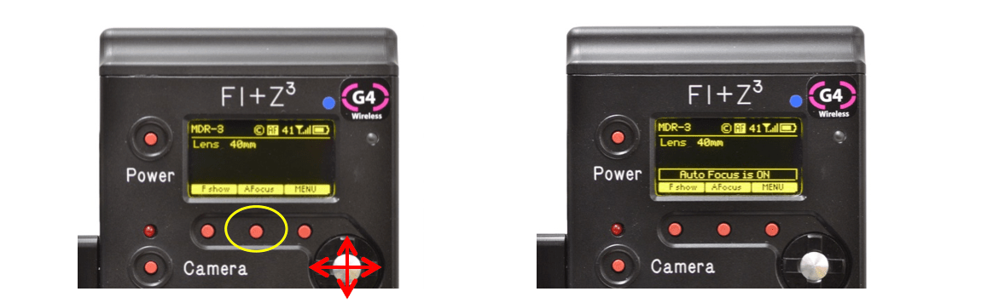
Manual Focus Mode/Auto Focus Mode
HU4 AF SWITCH
2 possibilities
Behind the grip
Touch screen
HU3 KEY

Slide 36
Transition AF Mode to Manual Mode
Use the background bars to make a smooth transition from AF mode to Manual mode. While in the AF mode, before switching to Manual mode, turn the focus knob to change the background bars beneath the red AF rectangle to green. The switch to Manual Mode will now be perfectly smooth.

Slide 37
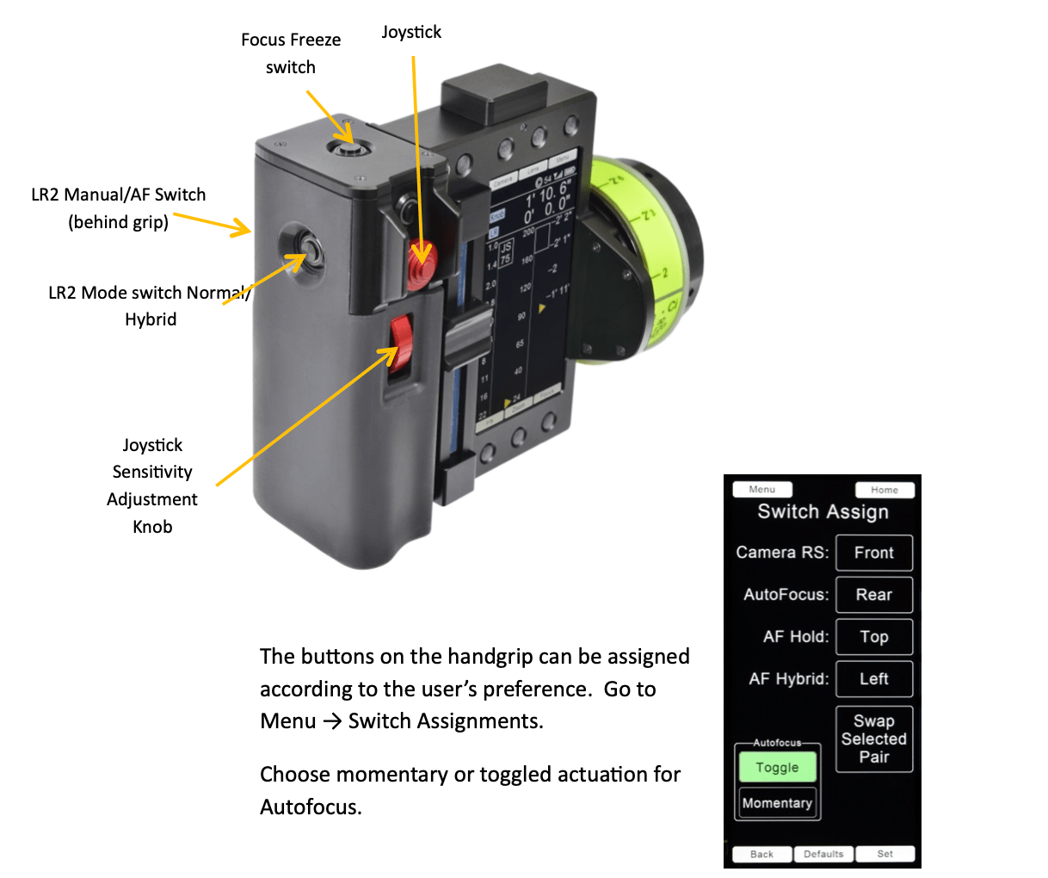
Transition AF Mode to Manual Mode
In Toggle mode, each switch actuation alternates between Manual mode and AF mode.
In Momentary mode, the AF mode is maintained as long as the switch remains depressed.

Slide 38
Hybrid Mode
In Manual mode, focus on the first subject.
Use the joystick to position the red AF rectangle over the subject where the focus pull will end.
Press the Hybrid switch momentarily. The letter H in yellow appears in the upper right corner of the frame and the AF rectangle turns yellow. (picture above, left)
Pull focus to the second subject. When the second subject is within the lens DOF, the mode will change to AF, “AF” will appear in red replacing the letter H and the AF rectangle will also turn red. (picture above, right)

Slide 39
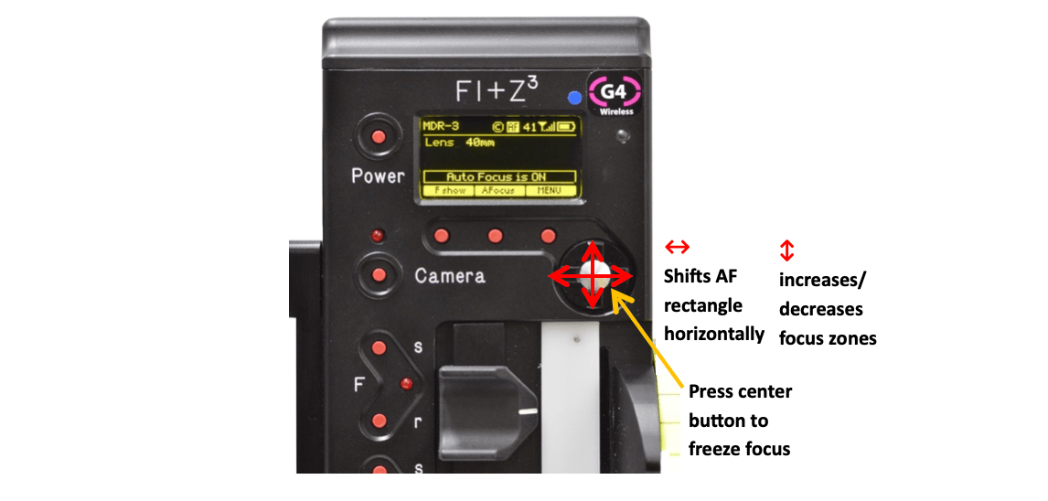
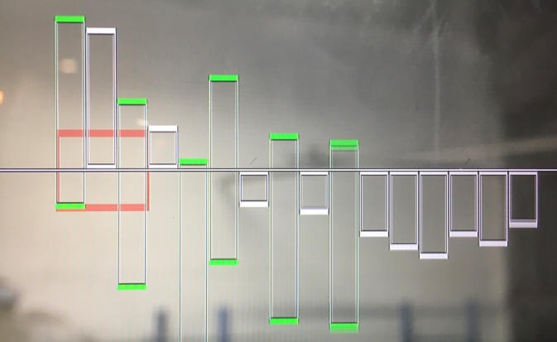
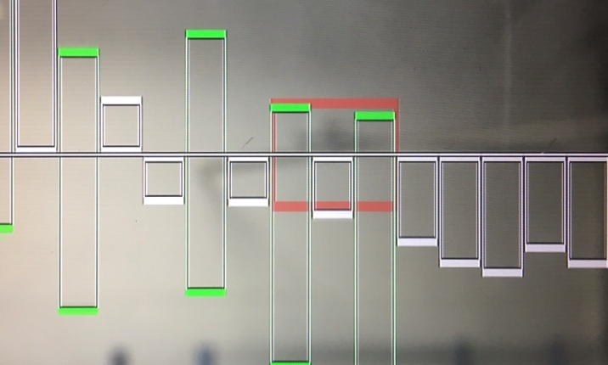
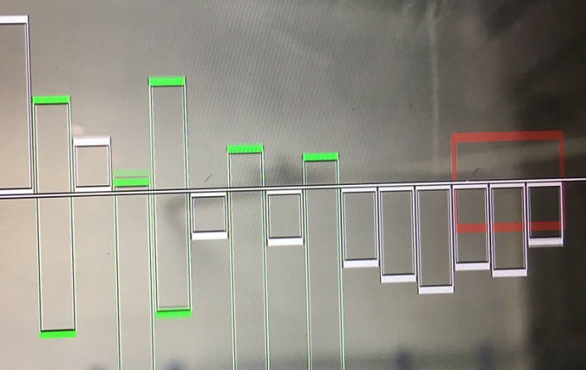
Control the AF zone from HU3
Set AF Mode (press middle key)

Slide 40
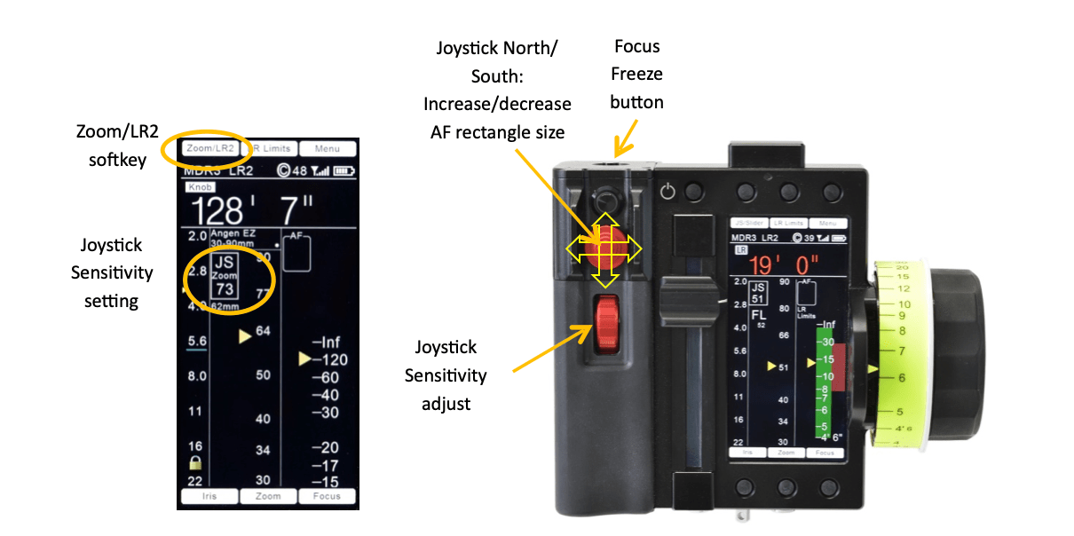
Control the AF zone from HU4
SET JS MODE
(instead of zoom)
Control AF ZONE

Slide 41
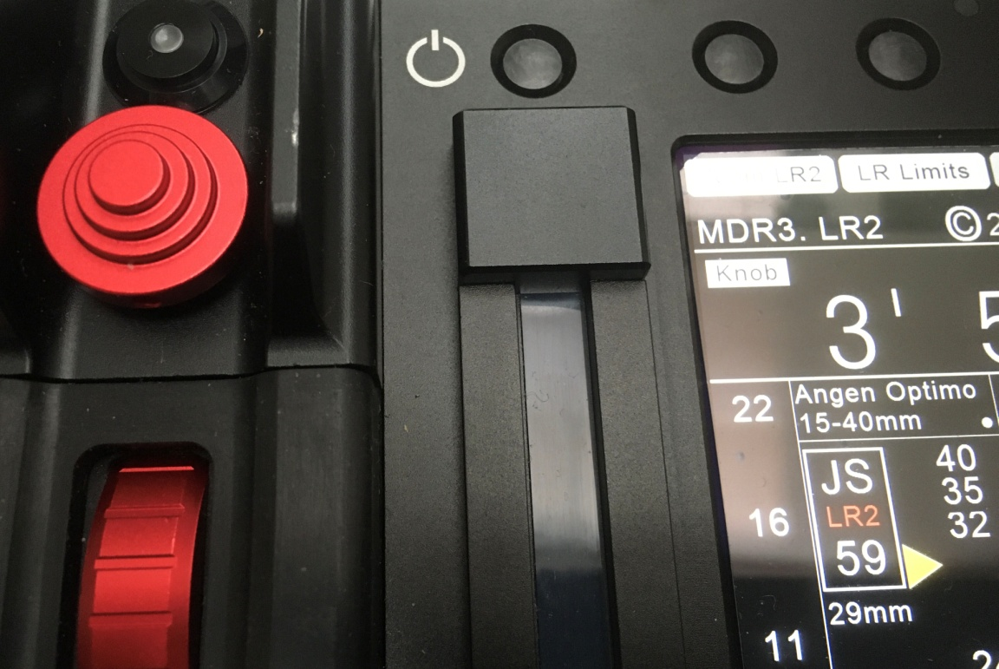
Sensitivity HU4 AF zone control
AF zone control
Choose sensitivity
AF zone control
from 1 to 99
Zoom focal

Slide 42
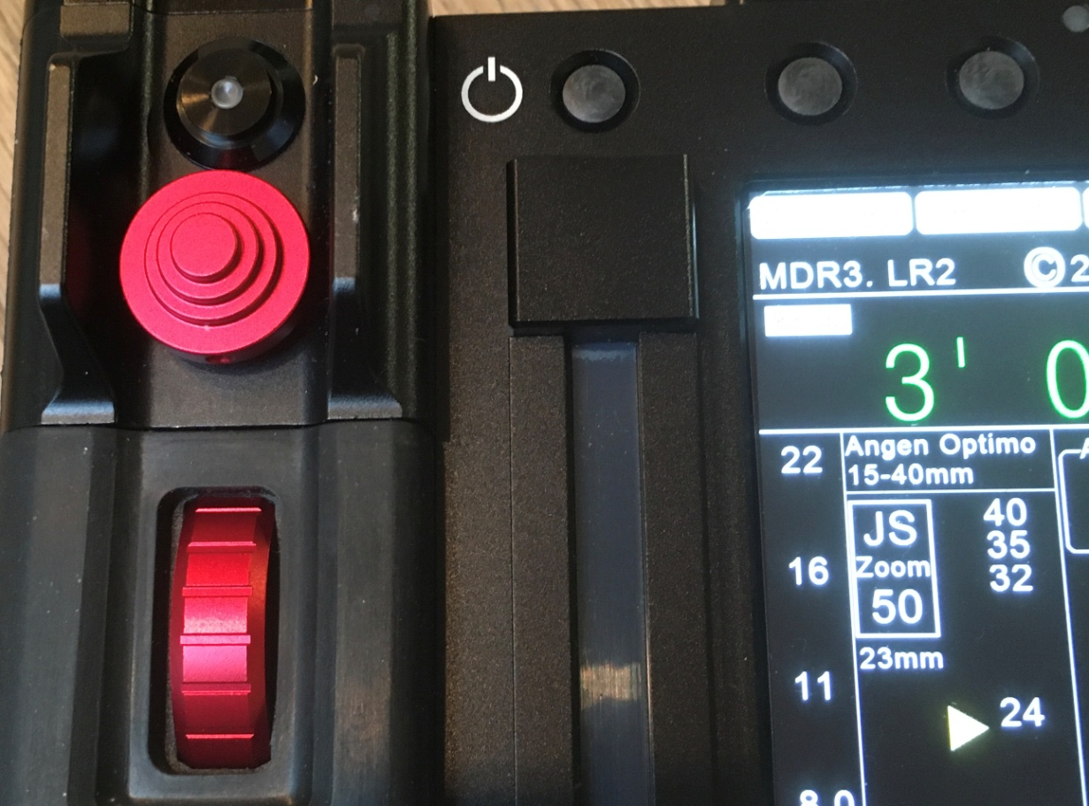
HU4 Zoom control
Zoom control
Zoom speed
From 1 to 99
Zoom focal

Slide 43
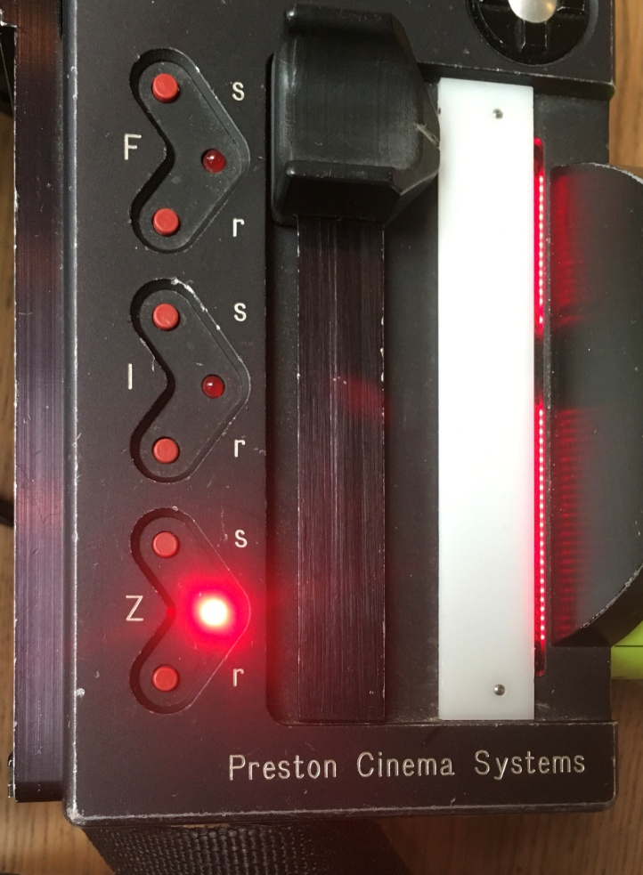
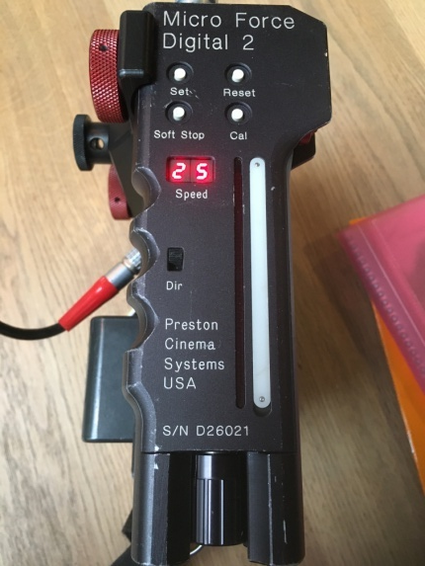
HU3 Focus Limits
Turn the focus knob to the first distance limit, press the button until red light and rotate the focus knob to the second limit.
Release the button
HU3 Zoom limits
Turn the zoom knob to the first distance limit, press the button until red light and rotate the zoom knob to the second limit. Release the button.

Slide 44
FREEZE FOCUS
Press center button
to freeze focus
Focus freeze button

Slide 45
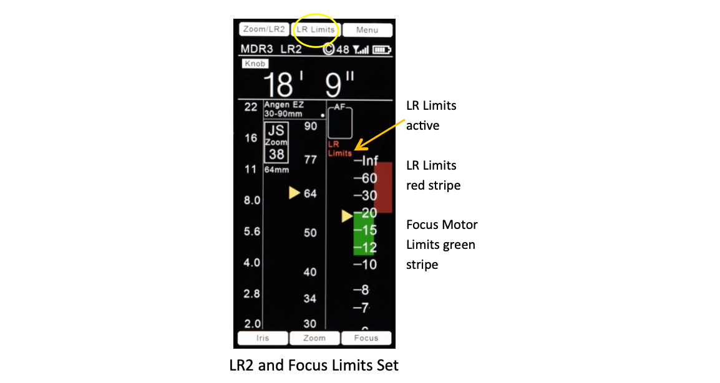
LR limits from HU4
To set LR Limits with the HU4, turn the focus knob to the first distance limit, press the button above “LR2 Limits”, and rotate the focus knob to the second limit. Release the button. The LR2 Limit is shown as a red stripe to the right of the focus scale. The warning “LR Limits” appears to the left of the focus scale

Slide 46
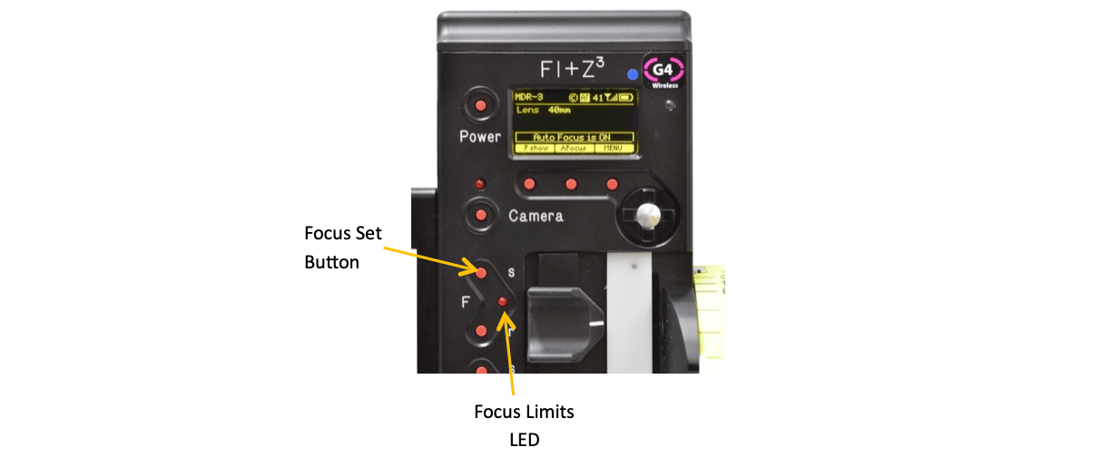
LR limit from HU3
Turn focus knob to the first limit distance.
Press and hole the Focus Set button.
Turn the focus knob to the second limit distance.
Release the button.
The red Focus Limits LED will turn on.

Slide 47


Lock iris/ Lock focus

Slide 48
HU4 UNIT features
Focus scale resolution increases as scale is expanded
Travel limits shown for focus, iris and zoom lens rings
Separate limits available for focus distance and LR2
Menu accessed by tactile keys or touch screen entry
Reversible black/white background for interior / exterior use
Non-linear iris scales are mapped to a linear scale

Slide 49

Choose the right
lens ring

Slide 50

Power
Antenna

Slide 51
Camera Start/Stop
(LED indicator ring
turns red when
camera runs)
Upper row of 3 tactile buttons for menu selections. Can also use touch screen below
Zoom control
Force sensor is built
in and also works as
joystick for LR2
focus area and
menu navigation
Zoom Speed
or Joystick
sensitivity
Iris Slider

Slide 52



HU4
Focus data
LR2 focus data
Focus data
And LR2 Focus data

Slide 53

Illumination settings

Slide 54

YOU HAVE TO KNOW ABOUT MDR
Power light has to be green.
If it’s flashing red, power is low.
You need to change camera battery.

Slide 55


